Slide 1
  Policy 1: No isolation of suspected or confirmed cases
  All patients are on a general ward, no isolation
 |  | Patient bed located in a side room or IPC cohort
 |  | Patient bed located in a general ward
 |  | C. difficile transmission, progression and recovery
 |  | Hospital population dynamics
S |  | Susceptible
C |  | Colonised (asymptomatic)
I |  | Infected (symptomatic)
X | test | Being tested
X | treat | Being treated
FN |  | False negatives awaiting retesting
D |  | Dead
λ | lambda | Force of colonisation
α | alpha | Rate of progression from colonisation to infection
γ | gamma | Suspected cases identification rate
θ | theta | Confirmed cases rate
π | pi | False negatives rate
σ | sigma | Retesting false negatives rate
δ | delta | Recovery rate (with return to a general ward)
μ | mu | Rate of decolonisation
d |  | Discharge rates (no discharges from Xtest)
a |  | Admission rates to S, C & I (in constant proportions)
m |  | Mortality rates
Hospital
D
m_{S}
m_{C}
m_{I}
m_{FN}
m_{Xtest}
m_{Xtreat}
δ
S
λ
α
γ
θ
C
I
X_{test}
X_{treat}
μ
π
σ
FN
a_{S}
d_{S}
a_{C}
d_{C}
a_{I}
d_{I}
d_{FN}
d_{Xtreat}
S
C
I
Community

Slide 2
  Policy 2: Isolate confirmed cases
  X_{treat} patients are in a side room or IPC cohort (isolated)
  All other patients are on a general ward
 |  | Patient bed located in a side room or IPC cohort
 |  | Patient bed located in a general ward
 |  | C. difficile transmission, progression and recovery
 |  | Hospital population dynamics
S |  | Susceptible
C |  | Colonised (asymptomatic)
I |  | Infected (symptomatic)
X | test | Being tested
X | treat | Being treated
FN |  | False negatives awaiting retesting
D |  | Dead
λ | lambda | Force of colonisation
α | alpha | Rate of progression from colonisation to infection
γ | gamma | Suspected cases identification rate
θ | theta | Confirmed cases rate
π | pi | False negatives rate
σ | sigma | Retesting false negatives rate
δ | delta | Recovery rate (with return to a general ward)
μ | mu | Rate of decolonisation
d |  | Discharge rates (no discharges from Xtest)
a |  | Admission rates to S, C & I (in constant proportions)
m |  | Mortality rates
Hospital
D
m_{S}
m_{C}
m_{I}
m_{FN}
m_{Xtest}
m_{Xtreat}
δ
S
λ
α
γ
θ
C
I
X_{test}
X_{treat}
μ
π
σ
FN
a_{S}
d_{S}
a_{C}
d_{C}
a_{I}
d_{I}
d_{FN}
d_{Xtreat}
S
C
I
Community

Slide 3
  Policy 3: Isolate suspected and confirmed cases
  X_{test} and X_{treat} patients are in a side room or IPC cohort (isolated)
  All other patients are on a general ward
 |  | Patient bed located in a side room or IPC cohort
 |  | Patient bed located in a general ward
 |  | C. difficile transmission, progression and recovery
 |  | Hospital population dynamics
S |  | Susceptible
C |  | Colonised (asymptomatic)
I |  | Infected (symptomatic)
X | test | Being tested
X | treat | Being treated
FN |  | False negatives awaiting retesting
D |  | Dead
λ | lambda | Force of colonisation
α | alpha | Rate of progression from colonisation to infection
γ | gamma | Suspected cases identification rate
θ | theta | Confirmed cases rate
π | pi | False negatives rate
σ | sigma | Retesting false negatives rate
δ | delta | Recovery rate (with return to a general ward)
μ | mu | Rate of decolonisation
d |  | Discharge rates (no discharges from Xtest)
a |  | Admission rates to S, C & I (in constant proportions)
m |  | Mortality rates
Hospital
D
m_{S}
m_{C}
m_{I}
m_{FN}
m_{Xtest}
m_{Xtreat}
δ
S
λ
α
γ
θ
C
I
X_{test}
X_{treat}
μ
π
σ
FN
a_{S}
d_{S}
a_{C}
d_{C}
a_{I}
d_{I}
d_{FN}
d_{Xtreat}
S
C
I
Community

Slide 4
Isolate |  |  | Model 1 Neither suspected nor confirmed cases | Model 2 Confirmed cases | Model 3 Suspected and confirmed cases
Patient states in isolation |  |  | None | Xtreat | Xtest and Xtreat
From | To | Parameter | Patient transfer required | Patient transfer required | Patient transfer required
I | Xtest | gamma | N | N | Y
Xtest | FN | pi | N | N | Y
FN | Xtest | sigma | N | N | Y
Xtest | Xtreat | theta | N | Y | N
Rate of arrivals to Xtest from I (I* gamma) relative to Model 1 |  |  |  | Same | Slower
Rate of exports from Xtest to Xtreat (Xtest * theta) relative to Model 1 |  |  |  | Slower | Same
Rate of exports from Xtest to FN (Xtest * pi) relative to Model 1 |  |  |  | Same | Slower
Rate of arrivals to Xtest from FN (FN * sigma) |  |  |  | Same | Slower
Values of theta and pi at 50% sensitivity |  |  | theta = pi Patients with a positive test result spend the same time in Xtest as patients with a negative test result | theta < pi Patients with a positive test result spend a longer time in Xtest than patients with a negative test result | theta > pi Patients with a negative test result spend a longer time in Xtest than patients with a positive test result
Expected effect on the number of secondary cases |  |  | Model 1 > Model 2 > Model 3
Expected effect on the number of missed cases relative to Model 1 Deaths in Xtest Deaths and discharges from FN |  |  |  | Higher Higher | Unsure as expect a lower rate of arrivals from I, but patients with a negative test result spend longer in Xtest Unsure as expect a lower rate of arrivals from Xtest, but patients spend longer in FN

Slide 5
  Simplified Model 1: No isolation of suspected or confirmed cases
  All patients are on a general ward, no isolation
 |  | Patient bed located in isolation
 |  | Patient bed located in a general ward
 |  | C. difficile transmission, progression and recovery
 |  | Hospital population dynamics
S |  | Susceptible
I |  | Infected (symptomatic)
X | test | Being tested
X | treat | Being treated
FN |  | False negatives awaiting retesting
D |  | Dead
λ | lambda | Force of colonisation
γ | gamma | Suspected cases identification rate
θ | theta | Confirmed cases rate
π | pi | False negatives rate
σ | sigma | Retesting false negatives rate
δ | delta | Recovery rate (with return to a general ward)
d |  | Discharge rates (no discharges from Xtest)
a |  | Admission rates to S, C & I (in constant proportions)
m |  | Mortality rates
Hospital
D
m_{S}
m_{I}
m_{FN}
m_{Xtest}
m_{Xtreat}
δ
S
λ
I
γ
X_{test}
θ
X_{treat}
π
σ
FN
a_{S}
d_{S}
d_{I}
d_{FN}
d_{Xtreat}
S
I
Community

Slide 6
  Simplified Model 2: Isolate confirmed cases
  X_{treat} patients are in isolation
  All other patients are on a general ward
 |  | Patient bed located in isolation
 |  | Patient bed located in a general ward
 |  | C. difficile transmission, progression and recovery
 |  | Hospital population dynamics
S |  | Susceptible
I |  | Infected (symptomatic)
X | test | Being tested
X | treat | Being treated
FN |  | False negatives awaiting retesting
D |  | Dead
λ | lambda | Force of colonisation
γ | gamma | Suspected cases identification rate
θ | theta | Confirmed cases rate
π | pi | False negatives rate
σ | sigma | Retesting false negatives rate
δ | delta | Recovery rate (with return to a general ward)
d |  | Discharge rates (no discharges from Xtest)
a |  | Admission rates to S, C & I (in constant proportions)
m |  | Mortality rates
Hospital
D
m_{S}
m_{I}
m_{FN}
m_{Xtest}
m_{Xtreat}
δ
S
λ
I
γ
X_{test}
θ
X_{treat}
π
σ
FN
a_{S}
d_{S}
d_{I}
d_{FN}
d_{Xtreat}
S
I
Community

Slide 7
  Simplified Model 3: Isolate suspected and confirmed cases
  Patients in X_{test} ad X_{treat} are isolated
  All other patients are on a general ward
 |  | Patient bed located in isolation
 |  | Patient bed located in a general ward
 |  | C. difficile transmission, progression and recovery
 |  | Hospital population dynamics
S |  | Susceptible
I |  | Infected (symptomatic)
X | test | Being tested
X | treat | Being treated
FN |  | False negatives awaiting retesting
D |  | Dead
λ | lambda | Force of colonisation
γ | gamma | Suspected cases identification rate
θ | theta | Confirmed cases rate
π | pi | False negatives rate
σ | sigma | Retesting false negatives rate
δ | delta | Recovery rate (with return to a general ward)
d |  | Discharge rates (no discharges from Xtest)
a |  | Admission rates to S, C & I (in constant proportions)
m |  | Mortality rates
Hospital
D
m_{S}
m_{I}
m_{FN}
m_{Xtest}
m_{Xtreat}
δ
S
λ
I
γ
X_{test}
θ
X_{treat}
π
σ
FN
a_{S}
d_{S}
d_{I}
d_{FN}
d_{Xtreat}
S
I
Community

Slide 8
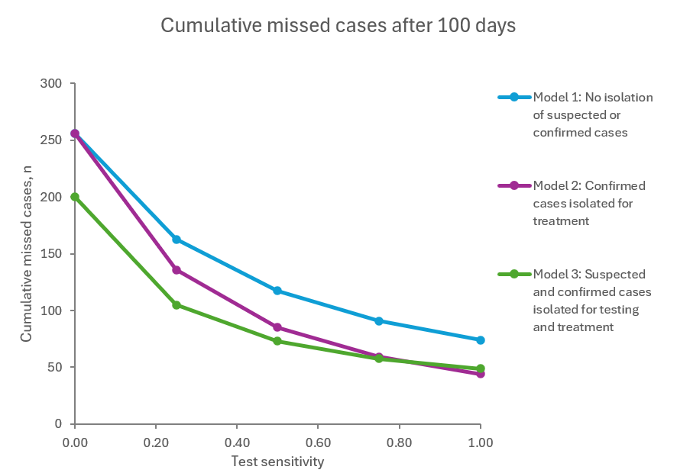
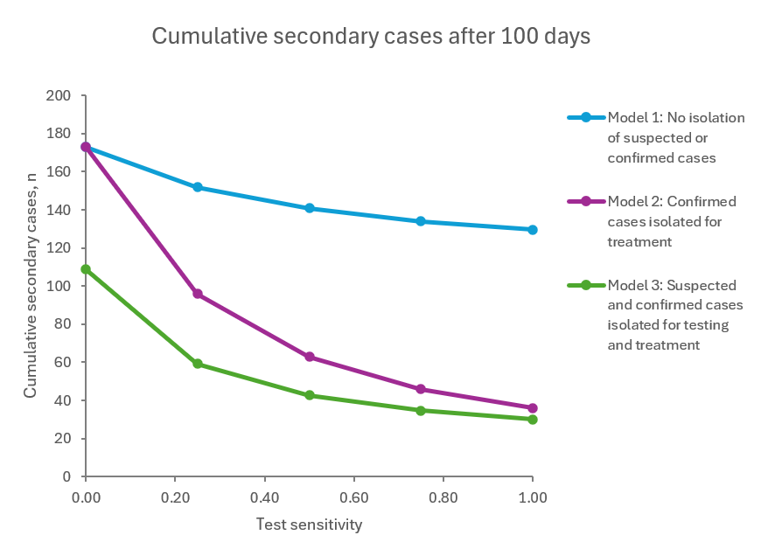
Results from a simplified model (no colonised state, patient transfer time = 0.5 days)
Model 1: Increasing sensitivity reduces cumulative missed cases
Model 2: Increasing sensitivity reduces cumulative missed cases, which are lower than Model 1 at sensitivity >0%
Model 3: Increasing sensitivity reduces cumulative missed cases, which are lower than Model 1 at all levels of sensitivity, and lower than Model 2 at sensitivity of 75% or less (but higher at 100%)
Model 1: Increasing sensitivity reduces cumulative secondary cases
Model 2: Increasing sensitivity reduces cumulative secondary cases, which are lower than Model 1 at sensitivity >0%
Model 3: Increasing sensitivity reduces cumulative secondary cases, which are lower than Models 1 & 2 for all levels of sensitivity.

Slide 9
 | Admitted infected | Admitted colonised, progress to infection during hospital stay | Become colonised but don’t progress to infection during hospital stay | Become colonised and progress to infection during hospital stay
Total cases | ✓ | ✓ |  | ✓
Hospital onset cases |  | ✓ |  | ✓
Hospital-acquired (secondary) cases |  |  |  | ✓

Slide 10
  Policy 1: No isolation of suspected or confirmed cases
  All patients are on a general ward, no isolation
 |  | Patient bed located in a side room or IPC cohort
 |  | Patient bed located in a general ward
 |  | C. difficile transmission, progression and recovery
 |  | Hospital population dynamics
S |  | Susceptible
C |  | Colonised (asymptomatic)
I |  | Infected (symptomatic)
X | test | Being tested
X | treat | Being treated
FN |  | False negatives awaiting retesting
D |  | Dead
λ | lambda | Force of colonisation
α | alpha | Rate of progression from colonisation to infection
γ | gamma | Suspected cases identification rate
θ | theta | Confirmed cases rate
π | pi | False negatives rate
σ | sigma | Retesting false negatives rate
δ | delta | Recovery rate (with return to a general ward)
μ | mu | Rate of decolonisation
d |  | Discharge rates (no discharges from Xtest)
a |  | Admission rates to S, C & I (in constant proportions)
m |  | Mortality rates
Hospital
D
m_{S}
m_{C}
m_{I}
m_{FN}
m_{Xtest}
m_{Xtreat}
δ
S
λ
α
γ
θ
C
I
X_{test}
X_{treat}
μ
π
σ
FN
a_{S}
a_{C}
d_{S}
d_{C}
a_{I}
d_{I}
d_{FN}
d_{Xtreat}
S
C
I
Community

Slide 11
  Policy 2: Isolate confirmed cases
  X_{treat} and T₂ patients are in a side room or IPC cohort (isolated)
  All other patients are on a general ward
 |  | Patient bed located in a side room or IPC cohort
 |  | Patient bed located in a general ward
 |  | C. difficile transmission, progression and recovery
 |  | Hospital population dynamics
S |  | Susceptible
C |  | Colonised (asymptomatic)
I |  | Infected (symptomatic)
X | test | Being tested
X | treat | Being treated
FN |  | False negatives awaiting retesting
T |  | Being transferred (general ward ⬄ side room)
D |  | Dead
λ | lambda | Force of colonisation
α | alpha | Rate of progression from colonisation to infection
γ | gamma | Suspected cases identification rate
θ | theta | Confirmed cases rate
π | pi | False negatives rate
σ | sigma | Retesting false negatives rate
δ | delta | Recovery rate (with return to a general ward)
μ | mu | Rate of decolonisation
τ | tau | Patient transfer rate (general ward ⬄ side room)
d |  | Discharge rates (no discharges from T₂ or X_{test})
a |  | Admission rates to S, C & I (in constant proportions)
m |  | Mortality rates
Hospital
τ
D
m_{T2}
T₂
m_{S}
m_{C}
m_{I}
m_{Xtest}
m_{Xtreat}
m_{T1}
δ
m_{FN}
S
λ
α
γ
C
I
X_{test}
X_{treat}
μ
π
θ
τ
σ
FN
T₁
a_{S}
d_{S}
a_{C}
d_{C}
a_{I}
d_{I}
d_{FN}
d_{T1}
d_{Xtreat}
S
C
I
Community

Slide 12
  Policy 3: Isolate suspected and confirmed cases
  X_{test}, X_{treat}, T₂ and T₃ patients are in a side room or IPC cohort (isolated)
  All other patients are on a general ward
 |  | Patient bed located in a side room or IPC cohort
 |  | Patient bed located in a general ward
 |  | C. difficile transmission, progression and recovery
 |  | Hospital population dynamics
S |  | Susceptible
C |  | Colonised (asymptomatic)
I |  | Infected (symptomatic)
X | test | Being tested
X | treat | Being treated
FN |  | False negatives awaiting retesting
T |  | Being transferred (general ward ⬄ side room)
D |  | Dead
λ | lambda | Force of colonisation
α | alpha | Rate of progression from colonisation to infection
γ | gamma | Suspected cases identification rate
θ | theta | Confirmed cases rate
π | pi | False negatives rate
σ | sigma | Retesting false negatives rate
δ | delta | Recovery rate (with return to a general ward)
μ | mu | Rate of decolonisation
τ | tau | Patient transfer rate (general ward ⬄ side room)
d |  | Discharge rates (no discharges from T₁, T₃ or X_{test})
a |  | Admission rates to S, C & I (in constant proportions)
m |  | Mortality rates
Hospital
τ
D
m_{T3}
T₅
m_{Xtreat}
m_{S}
m_{C}
m_{I}
m_{T1}
m_{Xtest}
δ
S
λ
α
θ
C
I
X_{test}
X_{treat}
μ
γ
π
τ
m_{FN}
T₃
σ
m_{T2}
FN
T₄
τ
a_{S}
d_{S}
a_{C}
d_{C}
a_{I}
d_{I}
d_{FN}
d_{T2}
d_{Xtreat}
S
C
I
Community

